Slide 1
Design Patterns
Structural Design Patterns
Behavioral Design Patterns
Creational Design Patterns

Slide 2
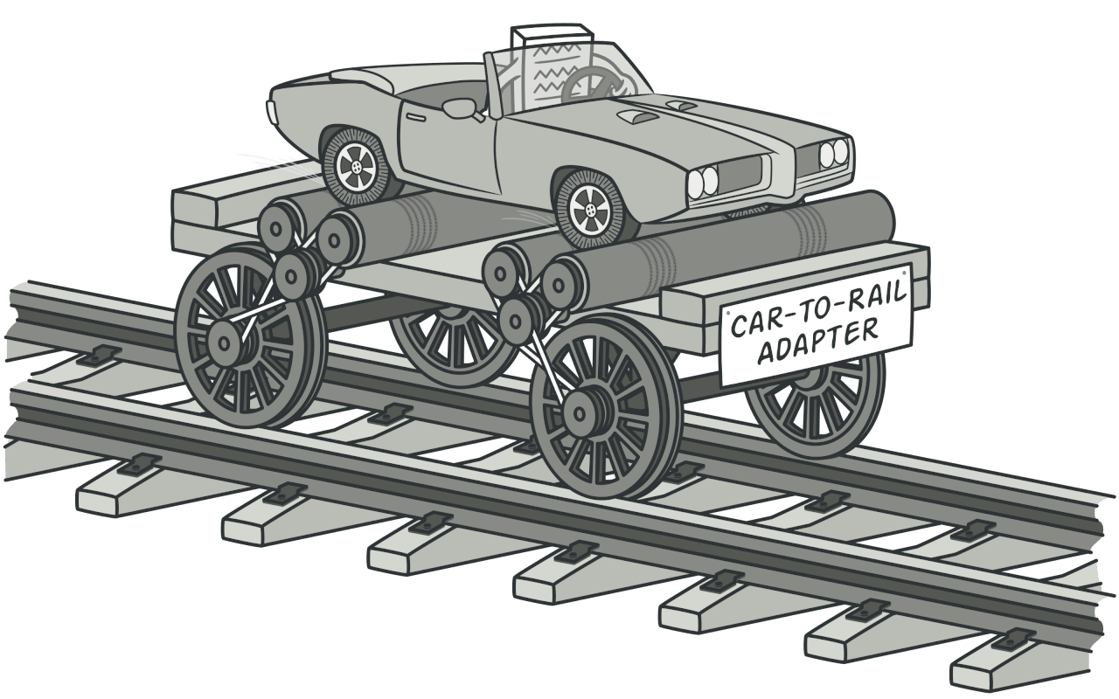
1. Adapter
Notes:
Adapter is a structural design pattern that allows objects with incompatible interfaces to collaborate.

Slide 3
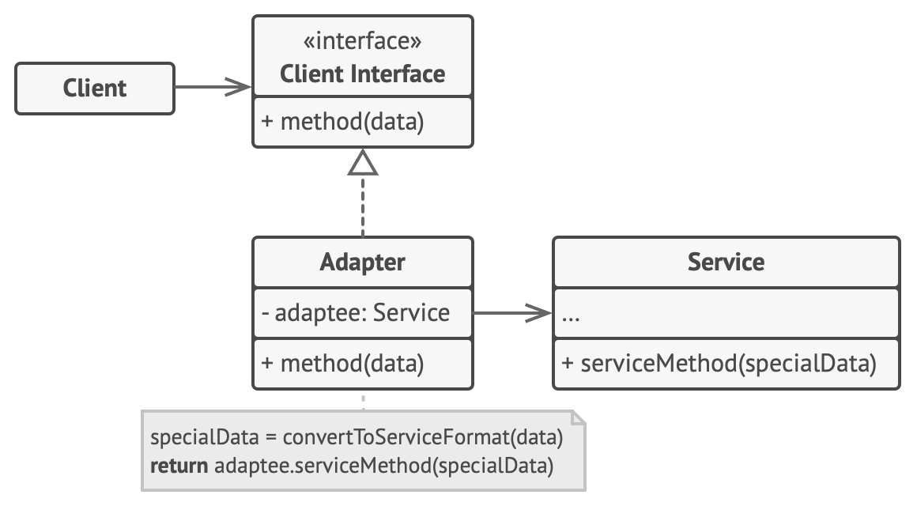
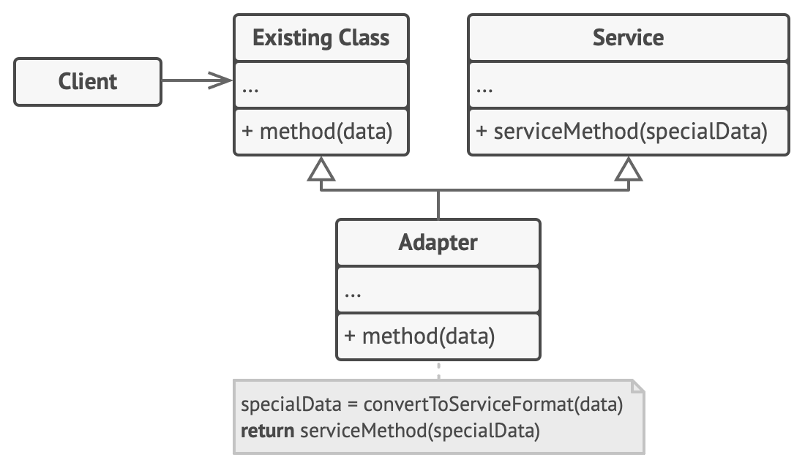
Target (Client Interface)
Adaptee (Service)
Adapter
Object Adapter
Class Adapter
Notes:
Depending on the implementation, it can also be divided into Object Adapter and Class Adapter.
The Client Interface describes a protocol that other classes must follow to be able to collaborate with the client code.
The Service is some useful class (usually 3rd-party or legacy). The client can’t use this class directly because it has an incompatible interface.
The Adapter is a class that’s able to work with both the client and the service: it implements the client interface, while wrapping the service object.
The adapter receives calls from the client via the adapter interface and translates them into calls to the wrapped service object in a format it can understand.

Slide 4
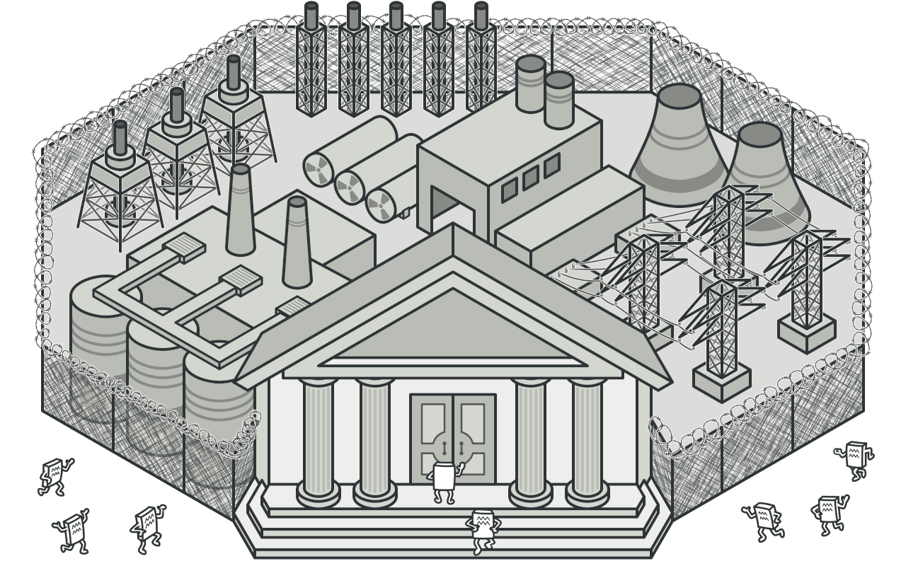
2. Facade
Notes:
Facade is a structural design pattern that provides a simplified interface to a library, a framework, or any other complex set of classes.
Imagine that you must make your code work with a broad set of objects that belong to a sophisticated library or framework.
Ordinarily, you’d need to initialize all those objects, keep track of dependencies, execute methods in the correct order, and so on.
As a result, the business logic of your classes would become tightly coupled to the implementation details of 3rd-party classes, making it hard to comprehend and maintain.

Slide 5
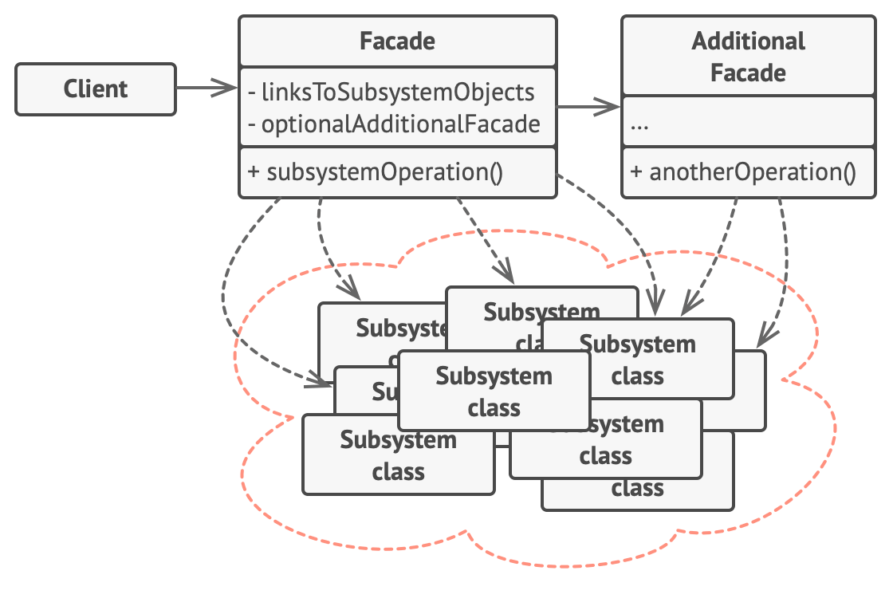
Facade
SubSystem
Notes:
The Facade provides convenient access to a particular part of the subsystem’s functionality. It knows where to direct the client’s request and how to operate all the moving parts.
The Complex Subsystem consists of dozens of various objects.
To make them all do something meaningful, you must dive deep into the subsystem’s implementation details, such as initializing objects in the correct order and supplying them with data in the proper format.
Subsystem classes aren’t aware of the facade’s existence. They operate within the system and work with each other directly.
An Additional Facade class can be created to prevent polluting a single facade with unrelated features that might make it another complex structure.
Additional facades can be used by both clients and other facades.

Slide 6
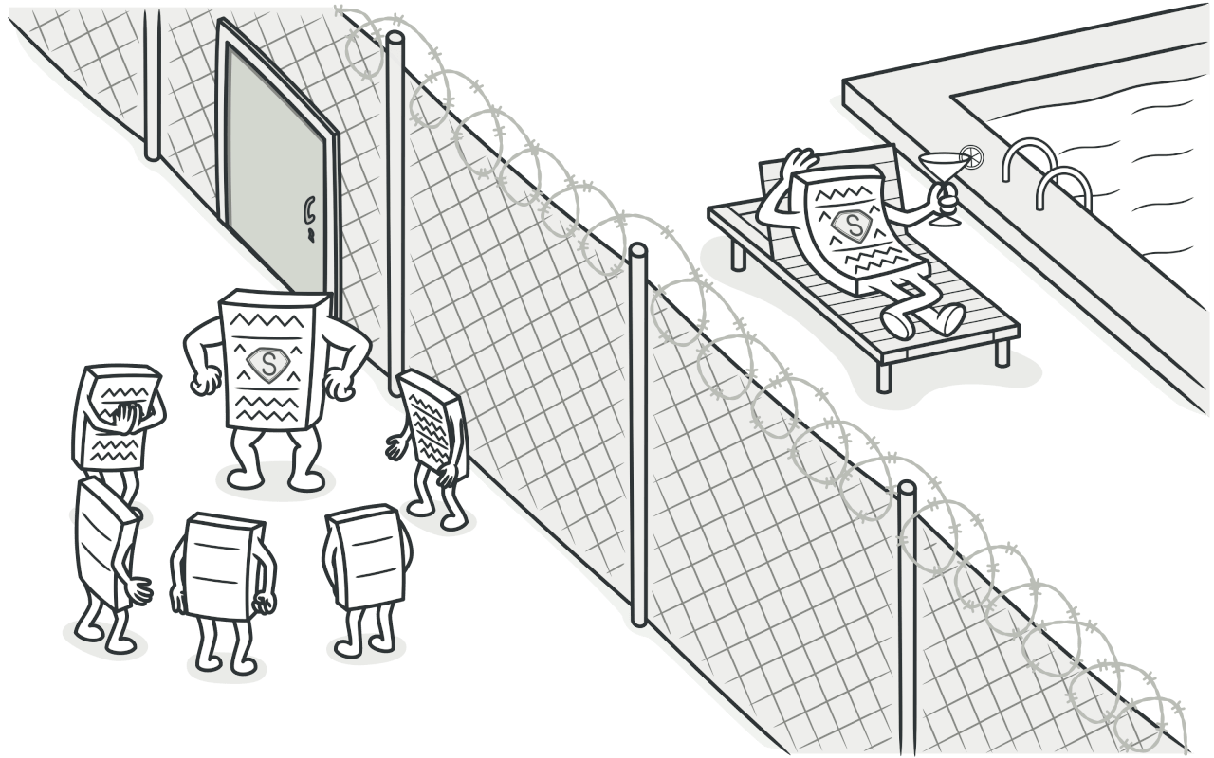
3. Proxy
Notes:
Proxy is a structural design pattern that lets you provide a substitute or placeholder for another object.
A proxy controls access to the original object, allowing you to perform something either before or after the request gets through to the original object.

Slide 7
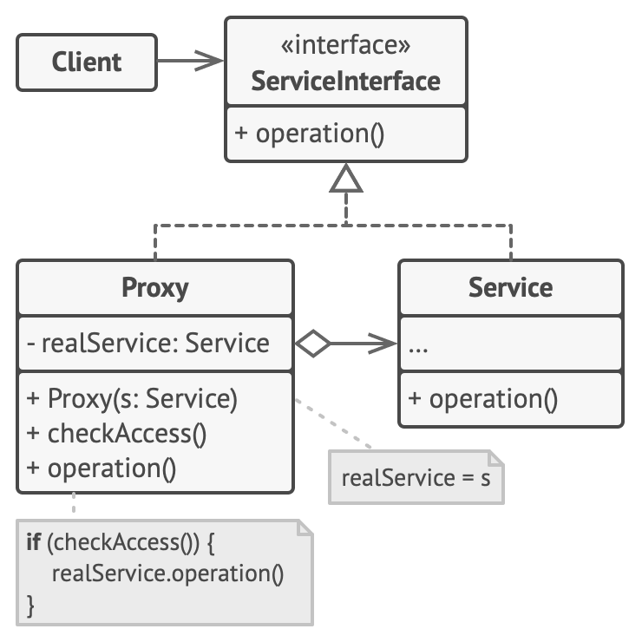
Subject
RealSubject
Proxy
Notes:
The Service Interface declares the interface of the Service. The proxy must follow this interface to be able to disguise itself as a service object.
The Service is a class that provides some useful business logic.
The Proxy class has a reference field that points to a service object.
After the proxy finishes its processing (e.g., lazy initialization, logging, access control, caching, etc.), it passes the request to the service object.
Usually, proxies manage the full lifecycle of their service objects.

Slide 8
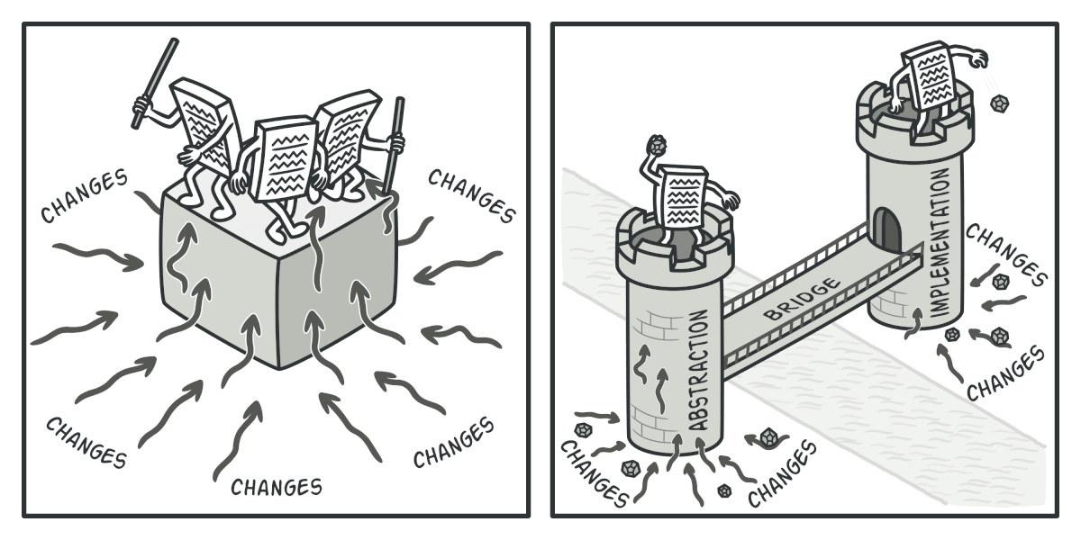
4. Bridge
Notes:
Bridge is a structural design pattern that lets you split a large class or a set of closely related classes into two separate hierarchies—abstraction and implementation—
which can be developed independently of each other.
Different implementations are interchangeable as long as they follow a common interface.

Slide 9
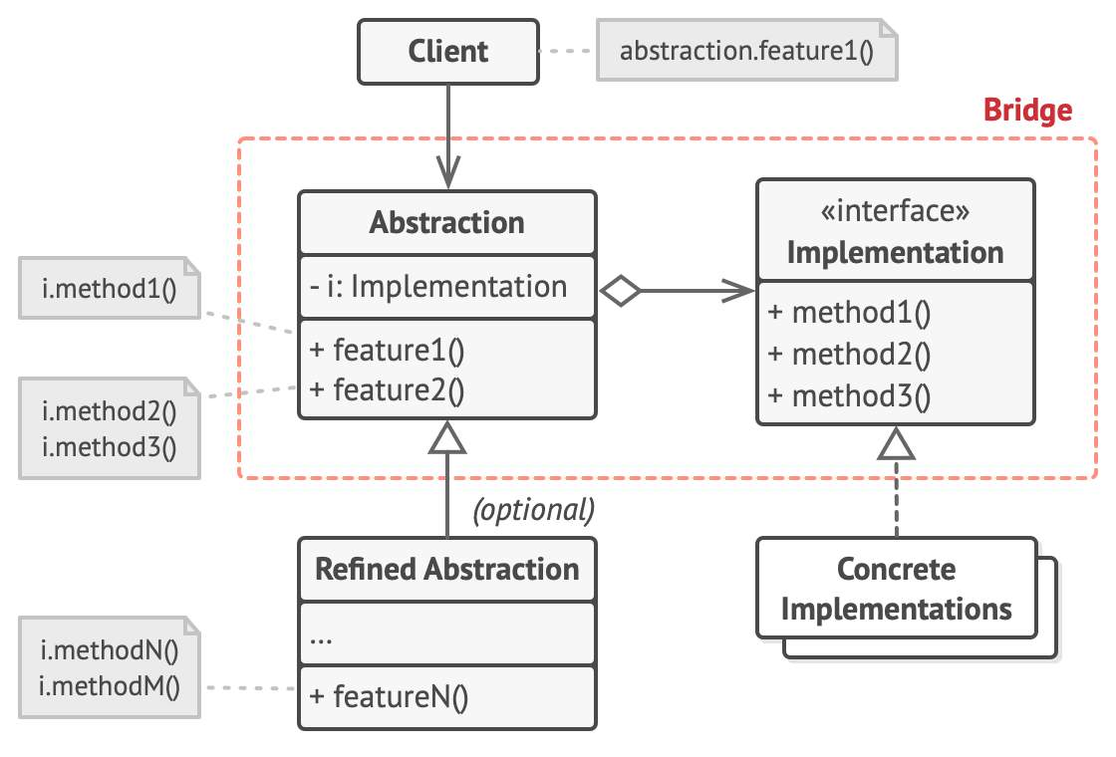
Abstraction
Refined Abstraction
Implementation
Concrete Implementations

Slide 10
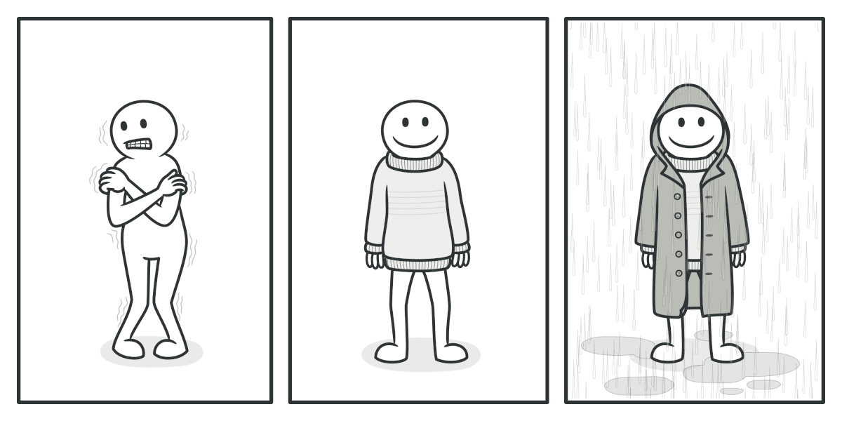
5. Decorator
Notes:
Decorator is a structural design pattern that lets you attach new behaviors to objects by placing these objects inside special wrapper objects that contain the behaviors.
Wearing clothes is an example of using decorators.
When you’re cold, you wrap yourself in a sweater.
If you’re still cold with a sweater, you can wear a jacket on top.
If it’s raining, you can put on a raincoat.
All these garments “extend” your basic behavior but aren’t part of you, and you can easily take off any piece of clothing whenever you don’t need it.

Slide 11
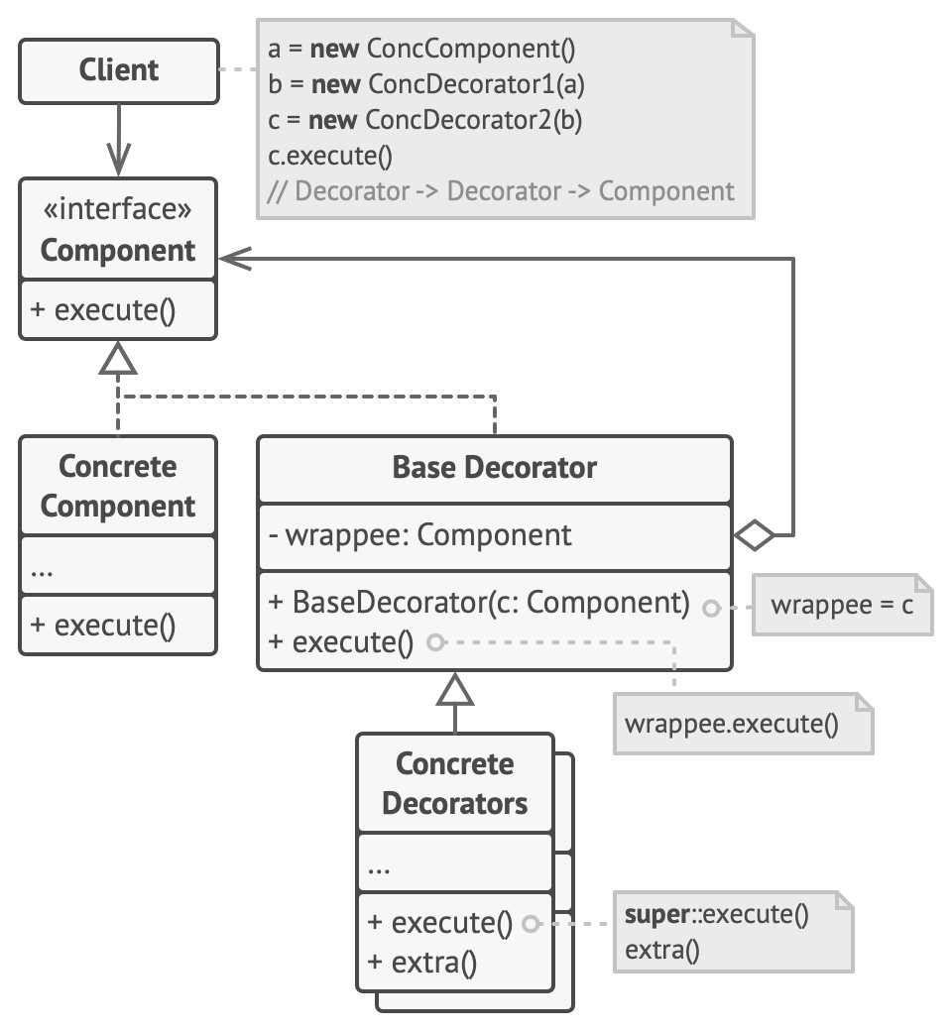
Component
ConcreteComponent
Base Decorator
ConcreteDecorator
Notes:
The Component declares the common interface for both wrappers and wrapped objects.
Concrete Component is a class of objects being wrapped. It defines the basic behavior, which can be altered by decorators.
The Base Decorator class has a field for referencing a wrapped object. The field’s type should be declared as the component interface so it can contain both concrete components and decorators.
The Base Decorator delegates all operations to the wrapped object.
Concrete Decorators define extra behaviors that can be added to components dynamically.
Concrete Decorators override methods of the base decorator and execute their behavior either before or after calling the parent method.

